Slide 1


pd.rolling.aggregates for Excel
An Excel Lambda function to mimic the functionality provided by Python Pandas rolling window functions

Slide 2
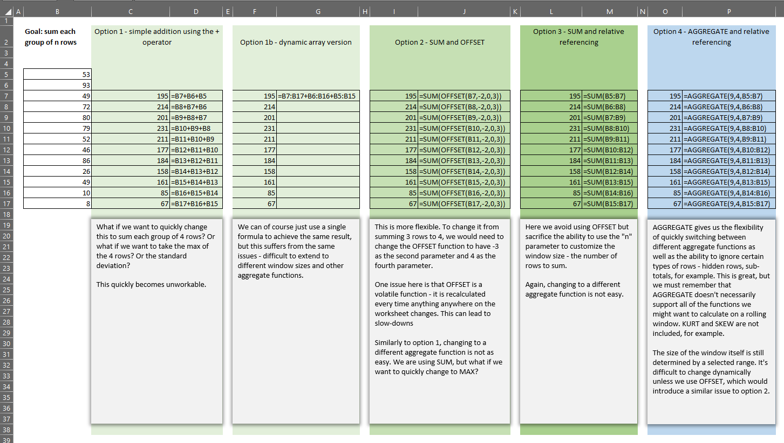
We have many options for rolling aggregates in Excel

Slide 3
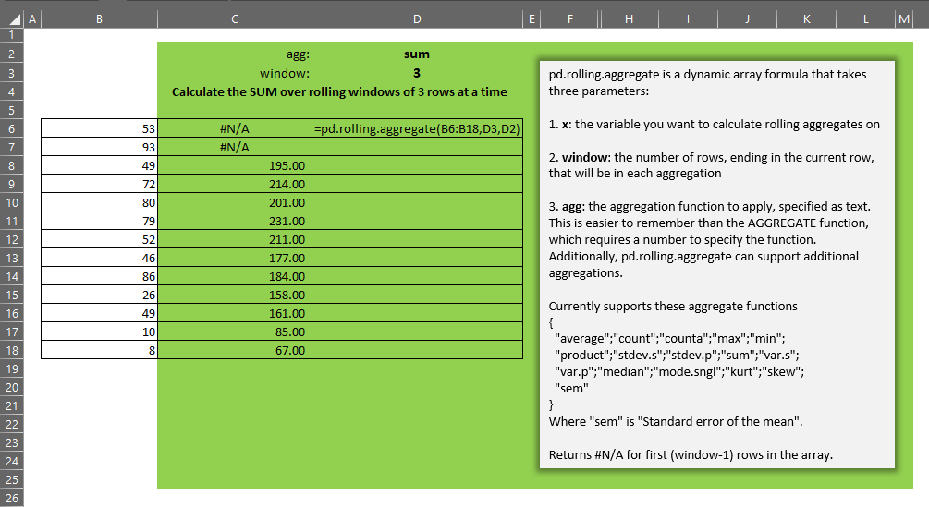
The lambda supports many functions and varying window sizes

Slide 4
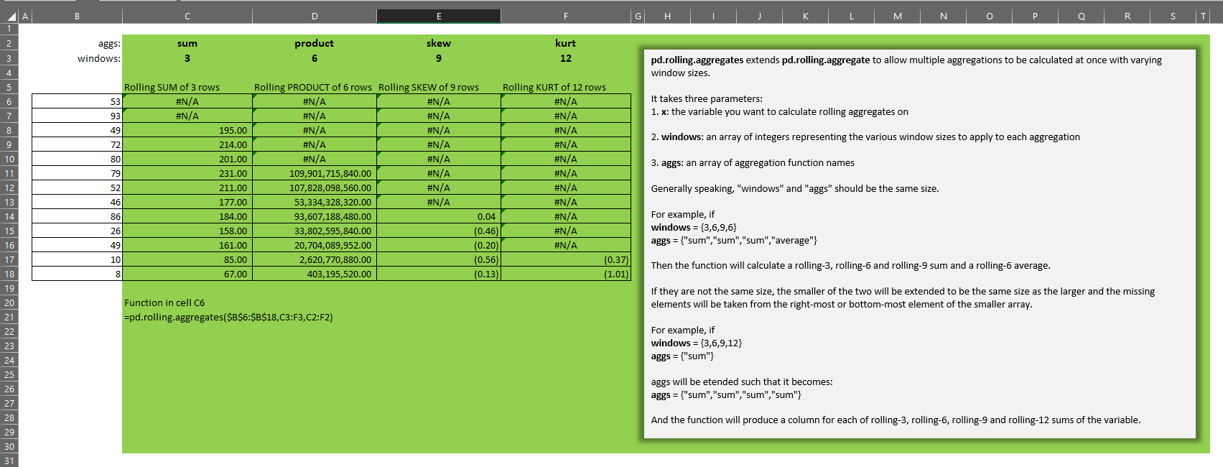
Use the plural version to calculate many combinations at once

